Slide 1
Sports Scheduling and Graph theory
By Barbara Lynn Cefaratti

Slide 2
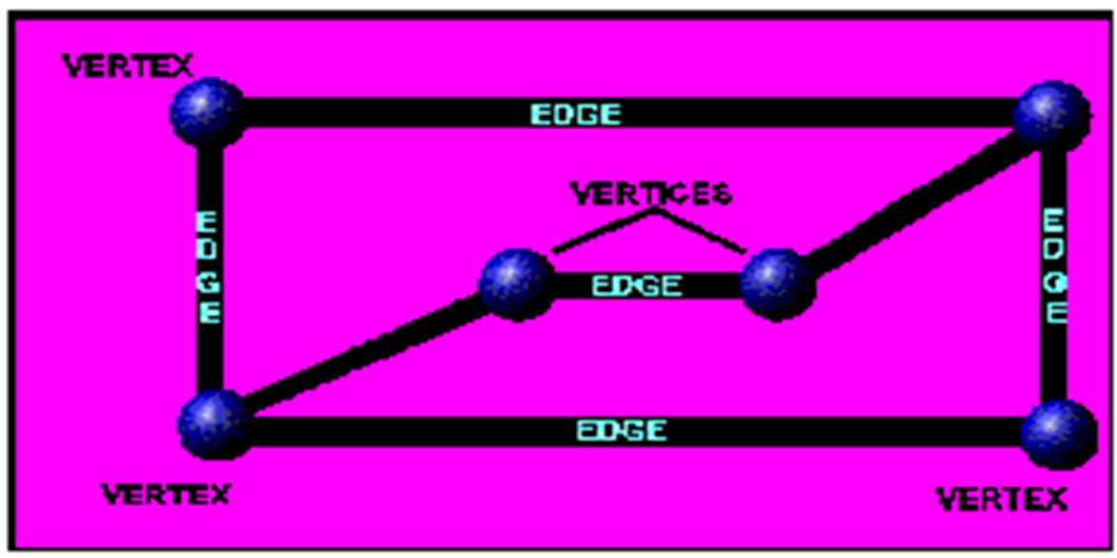
What is graph theory
Graph theory has nothing in common with graphs of functions.
A graph consists of a set of points, called vertices (singular form vertex), and a set of lines, called edges. Each edge joins two vertices.
Scheduling sports schedules using graph theory, helps athletic directors, managers, and executives create schedules that are fair and work best for their athletes and coaches.

Slide 3
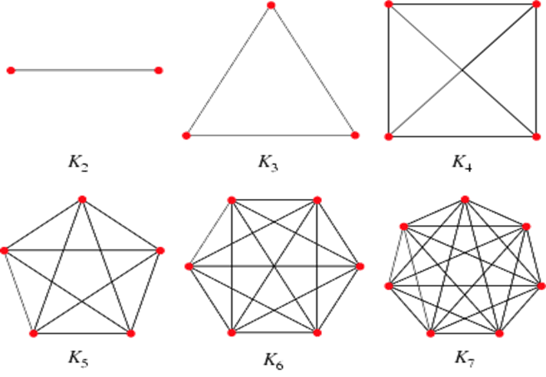
Complete Graph
A complete graph is a graph in which each pair of graph vertices is connected by an edge.
A complete graph with n vertices denoted by Kn is a graph with n vertices in which each vertex is connected to each of the others.
A complete graph can be viewed as a model of a round robin tournament in a natural way. Each vertex represents one team, and an edge joining two vertices, i and j, represents a game between the corresponding teams, i---j.

Slide 4
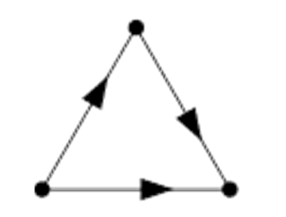
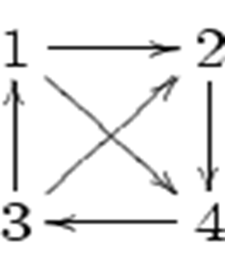
Round Robin with graph theory
In a round robin tournament, a given collection of teams play a competition such that every two teams play each other a fixed number of times.
A tournament is a directed graph which results from assigning unique directions to the edges of a complete graph.

Slide 5
Round robin
If there are n number of competitors, a round robin tournament requires $\frac{n}{2}$(n-1) games.
If n is even, then in each of (n-1) rounds, $\frac{n}{2}$ games can be run in parallel.
If n is odd, there will be n rounds, each with $\frac{n−1}{2}$ games, and one competitor having no game in that round.
We can assign each competitor a number and pair them off in the round. We then can fix one competitor and rotate the others clockwise one position.

Slide 6
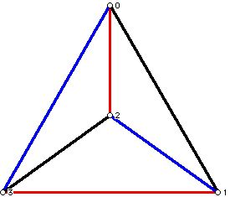
4 Teams
Consider first the case where there are 4 teams that must play each other. This means a total of 4(3)/2 = 6 matches must be played. These matches could be played in 6 time slots, say one a week for 6 weeks. However, it might be desirable if venues for the matches are available to have several matches per time slot and the games be completed over a shorter period of time. Thus, since there are 4 players, and 4/2 is 2, we could consider having two matches per time slot, and complete the tournament in three weeks rather than 6 weeks.
Edges in the graph that have the same color would occur during one time slot. Blue round had (0,3 and 1,2). Red Round (0,2 and 1,3). Black round had (0,1 and 2,3).

Slide 7
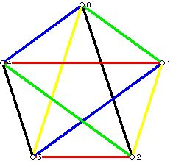
5 Teams
5 teams means we have 10 rounds. With one team having a bye each round.
The edges in different colors signify which teams play in an each round. The two yellow edges have teams 0 and 3 and 1 and 2 play each other in a single round; with team 4 getting a bye.

Slide 8
6 teams
1 | 2 | 3
6 | 5 | 4

Slide 9
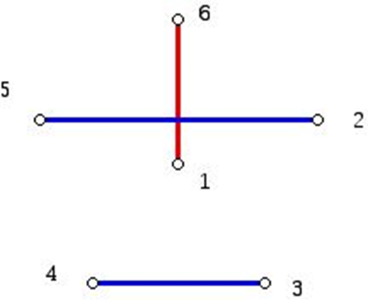
Round 1
The edge 1 to 6 is shown vertically in a diagram where the vertex 1 is placed at the "center" of a regular pentagon and the numbers 2 and 3 are listed clockwise starting from 1, while the numbers 5 and 4 are shown counterclockwise starting at 6. In the diagram shown the edges which make up the sides of the regular convex pentagon are omitted. Only the edges which make up the pairings in one round for the teams are shown.

Slide 10
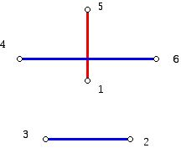
Round 2
1 | 6 | 2
5 | 4 | 3

Slide 11
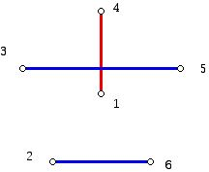
Round 3
Keep repeating the rotation operation until we exhaust the new pairings and return to the start.
1 | 5 | 6
4 | 4 | 2

Slide 12
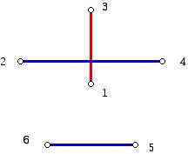
Round 4
1 | 4 | 5
3 | 2 | 6

Slide 13
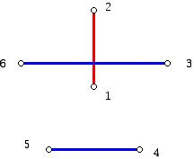
Round 5
1 | 3 | 4
2 | 6 | 5

Slide 14
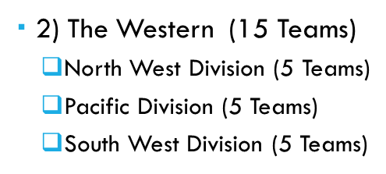
NBA scheduling
The National Basketball Association consists of thirty teams that play during a season running from the first week of November to the last week of April.
The NBA is divided into two conferences which is even further divided into divisions such that each conference is divided into 3 divisions:
1) The Eastern (15 Teams)
Atlantic Division (5 Teams)
Central Division (5 Teams)
South East Division (5 Teams)

Slide 15
Guidelines to follow
Every Team will play 16 Division Games.
8 Home Games and 8 Away Games
Every Team Will Play 30 Conference Games.
Home and Away Games will vary.
Every Team Will Play 30 Non-Conference Games.
15 Home Games and 15 Away Games
Therefore, each team will play a total of 76 games
For a total of 1,140 games to be scheduled.
240 Division Games
450 Conference Games
450 Non-Conference Games

Slide 16
Nba and graph theory

Slide 17
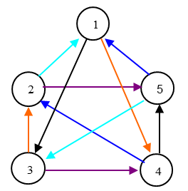
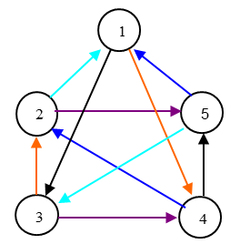
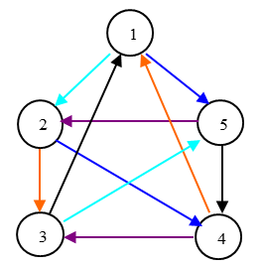
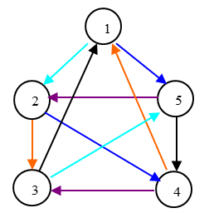
Nba Divisions

Slide 18
Scheduling Conference Games
3 Idle
1 Idle
5 Idle

Slide 19
Conference Games:
1
2
3
4
5
5
1
2
3
4
6
11
7
15
7
12
8
11
8
13
9
12
9
14
10
13
10
15
6
14
4
5
1
2
3
3
4
5
1
2
8
14
9
13
9
15
10
14
10
11
6
15
6
12
7
11
7
13
8
12

Slide 20
Scheduling League Days
Day 5
1
2
3
4
5
6
7
8
9
10
11
12
13
14
15
1
2
3
4
5
6
7
8
9
10
11
12
13
14
15
Day 6
1
2
3
4
5
6
7
8
9
10
11
12
13
14
15
1
2
3
4
5
6
7
8
9
10
11
12
13
14
15

Slide 21
Day 7
1
2
3
4
5
6
7
8
9
10
11
12
13
14
15
1
2
3
4
5
6
7
8
9
10
11
12
13
14
15
Day 8
1
2
3
4
5
6
7
8
9
10
11
12
13
14
15
1
2
3
4
5
6
7
8
9
10
11
12
13
14
15
Day 15
1
2
3
4
5
6
7
8
9
10
11
12
13
14
15
1
2
3
4
5
6
7
8
9
10
11
12
13
14
15

Slide 22
Work Cited
http://www.mathaware.org/mam/2010/essays/FroncekTournament.pdf
http://www.ams.org/samplings/feature-column/fcarc-sports
https://kkinder22.files.wordpress.com/
http://www.mathaware.org/mam/2010/essays/FroncekTournament.pdf

